Slide 1

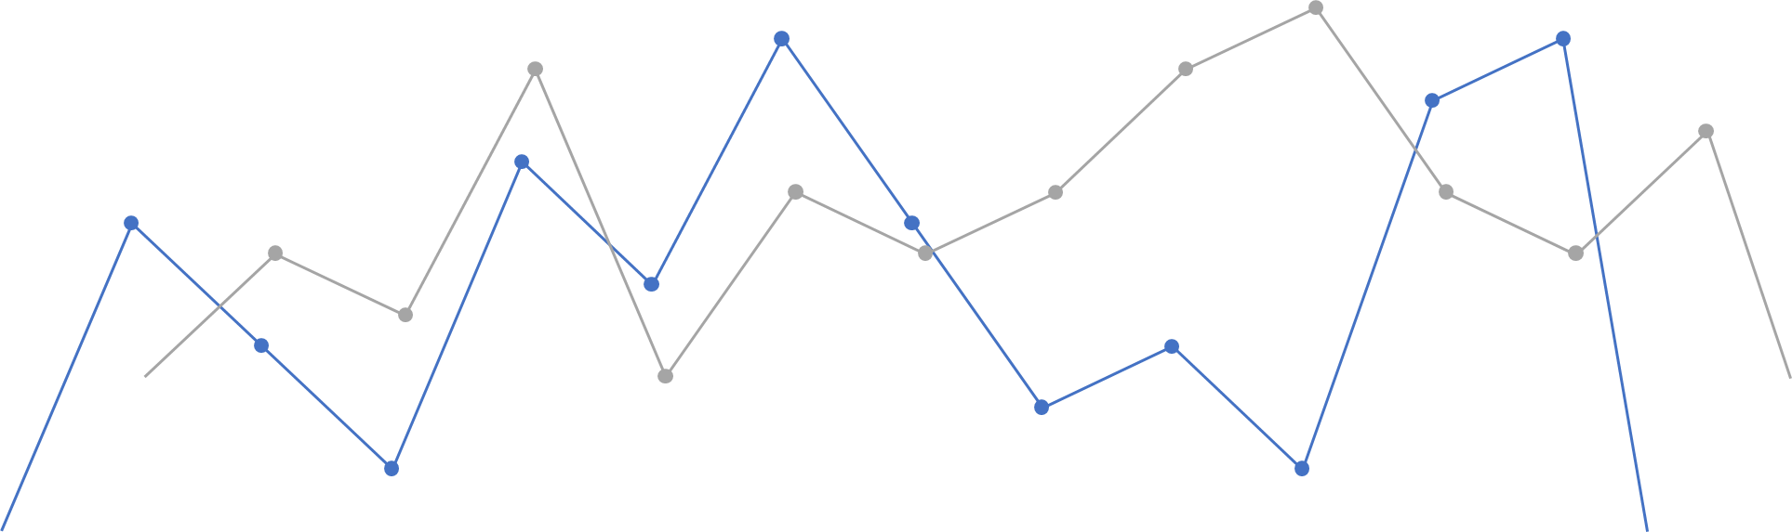
Evolving Markets A Data-Driven Approach to Understand ETF Trends

Slide 2

Agenda
Introduction
Importance
Execution
Best model selection
Light on Facts and findings
Portfolio Allocation
Code Overview

Slide 3
Team Member and Contribution
Aryan
Data selection, Data cleaning
Parthkumar, Mitesh
Exploratory analysis, Model testing and Implementation
Mitesh, Ketan
Visualization and quality check
Ketan
Final Presentation

Slide 4
Introduction
Welcome to our presentation on analyzing market trends of Exchange-Traded Funds (ETFs) using various algorithms. As the investment landscape continues to evolve, ETFs have emerged as a popular choice for investors seeking diversified exposure to a wide range of assets.
With their simplicity, liquidity, and cost-effectiveness, ETFs have captured the attention of both retail and institutional investors alike.
Today, our team from Evolving Markets is excited to share our insights into the dynamic world of ETF trading. Through the lens of different algorithms and predictive models, we have deep dive into historical data to uncover patterns, trends, and opportunities within the ETF market.

Slide 5
Why Time Series analysis needed for ETF’s Prediction
Temporal Dependencies: Price is often influenced by past prices. Time series models are designed to capture and leverage these dependencies, allowing for more accurate predictions.
Historical Patterns: ETF prices often exhibit repeating patterns and trends over time. Time series analysis techniques, such as moving averages, exponential smoothing, and ARIMA models, are effective at identifying and extrapolating these patterns into the future.
Seasonality and Trends: Many ETFs are affected by seasonal factors and long-term trends.
Volatility and Risk Management: Time series analysis can help identify and quantify volatility in ETF prices.
Forecasting: Time series models provide a framework for forecasting future ETF prices based on historical data.
Model Interpretability: Many time series models are relatively simple and interpretable, making it easier for investors to understand the factors driving ETF price movements and the rationale behind predictions.
Data Availability: ETF price data is readily available and typically comes with a timestamp.

Slide 6

Moving towards Model execution
7 ETF | Ticker
MSCI World SRI | SUSW.MI
MSCI Europe SRI | IESE.AS
Future Mobility ESG | ELCR.PA
Green Bonds | GRON.F
Global Clean Energy | ICLN
Markets ESG | AYEM.DE MSCI
Global Real Estate ESG | DJRE.AX
Calculate MAE, MSE, RMSE
LSTM Model, Train Test and Predict
Single, Double and Triple Exponational Smoothing
Cumulative Log- Return and Portfolio Optimization
XGBoost Model, Train Test and Predict
Data collection and data Cleaning
ARIMA Model, Train Test and Predict
Find out Moving and Weighted MA

Slide 7

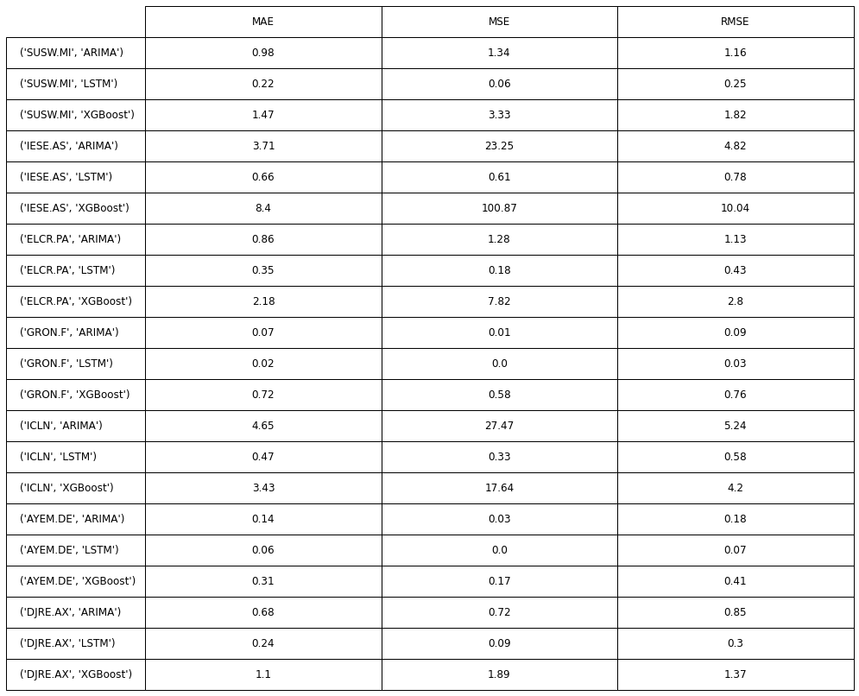

Which Model is Best
Mean Absolute Error
Mean Square Error
Root Mean Square Error
LSTM
ARIMA
XGBoost

Slide 8
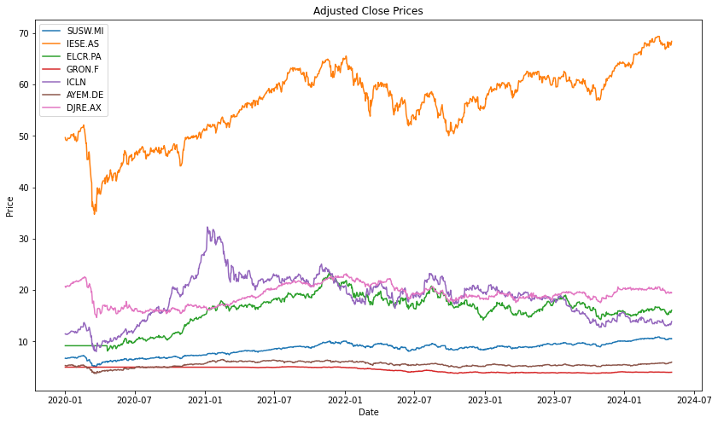
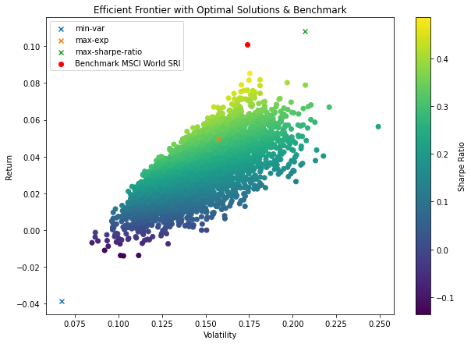
7 ETF’s Close Price
Benchmark MSCI world SRI

Slide 9
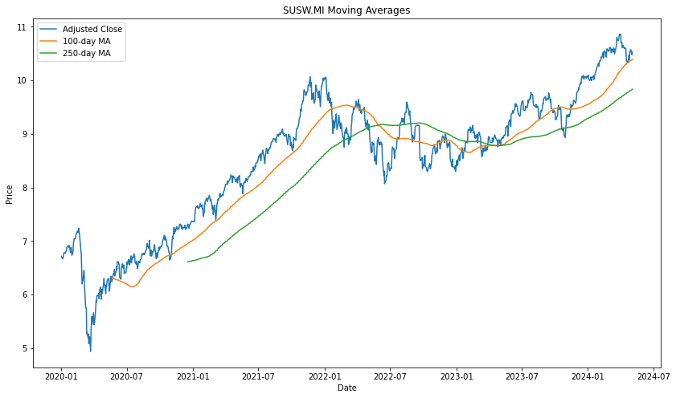
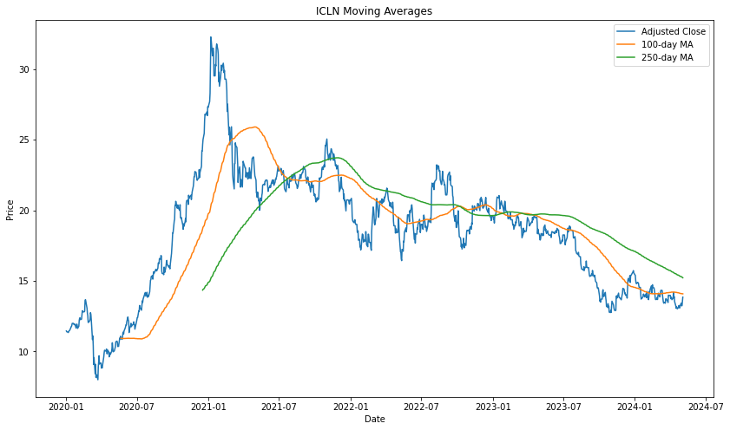
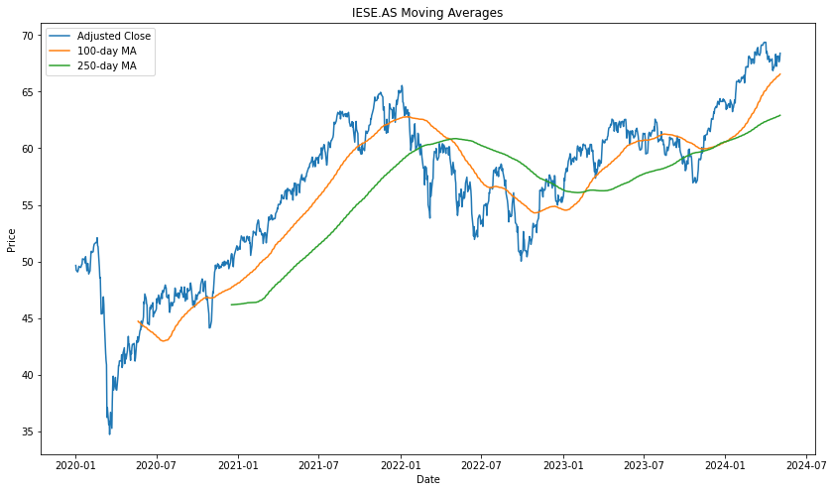
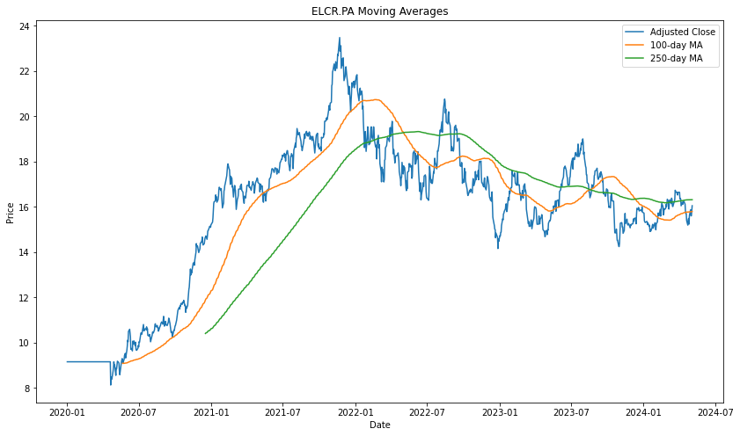
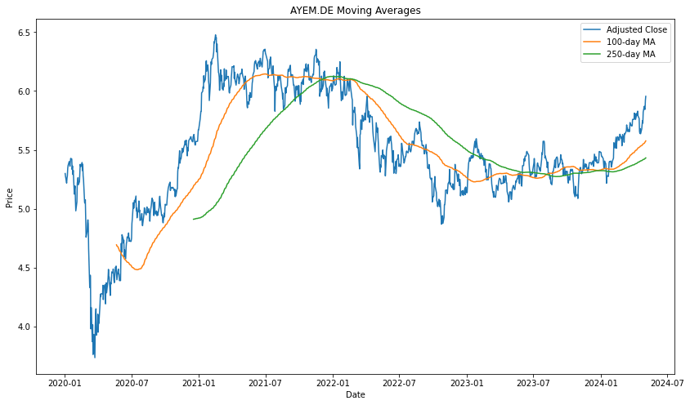
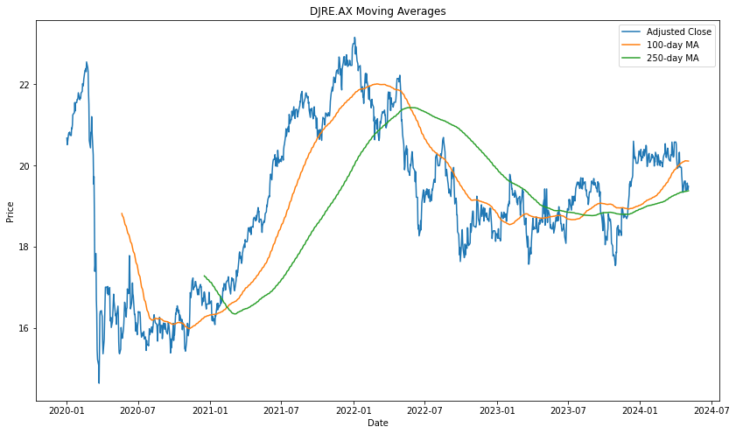
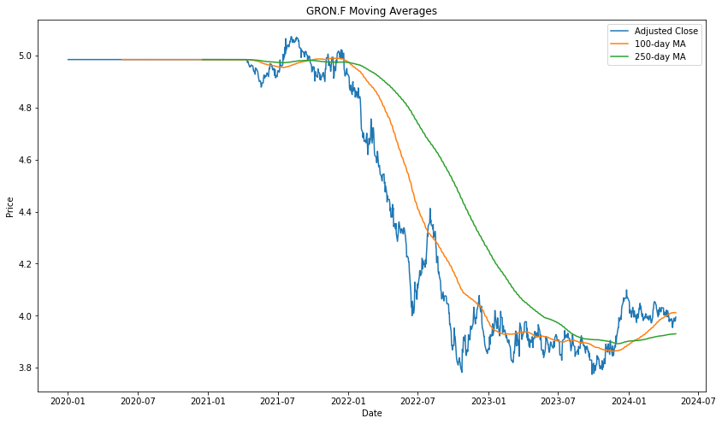
7 ETF’s Moving Average with 100 and 250 Day

Slide 10
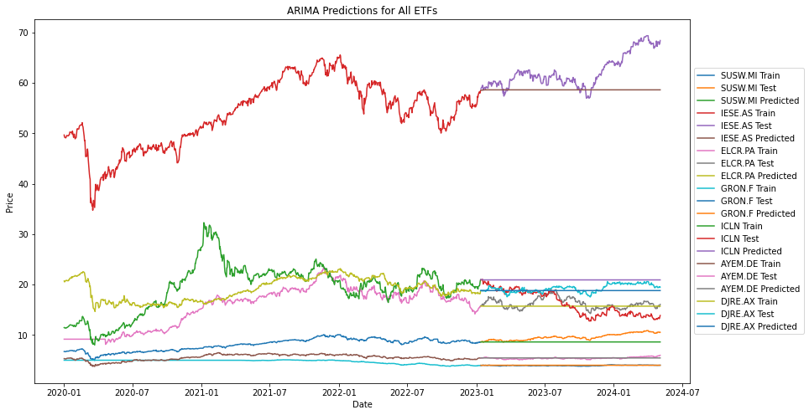
ARIMA Prediction for all ETF’s

Slide 11
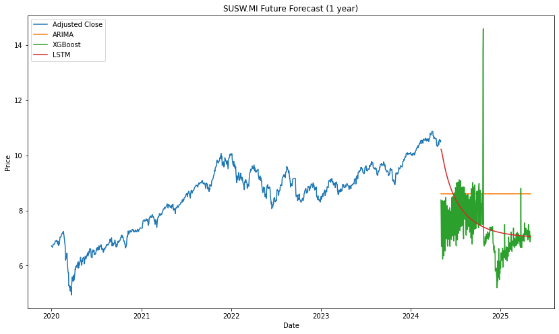
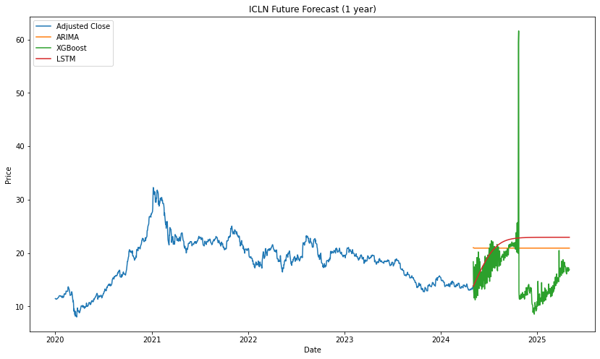
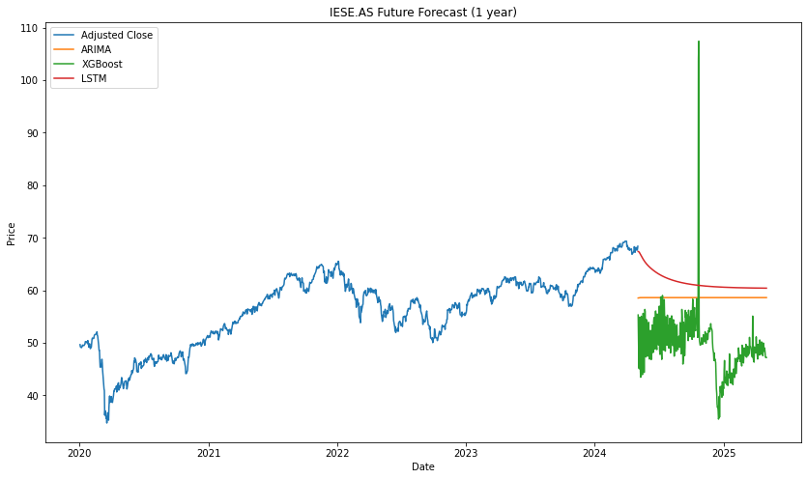
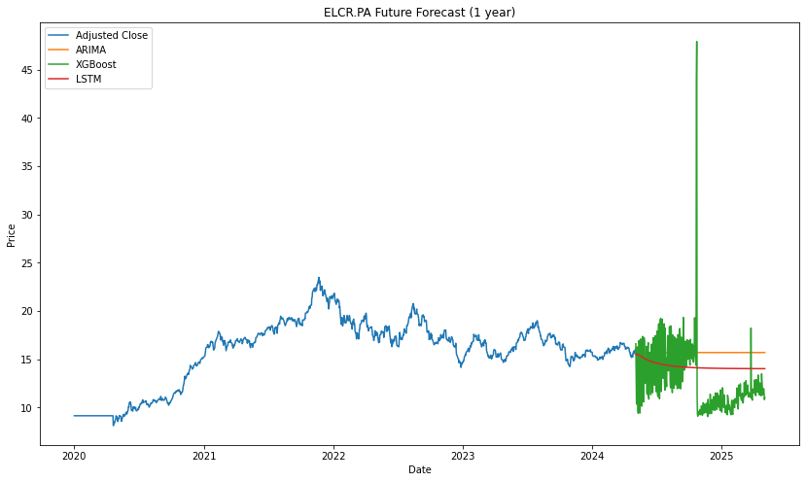
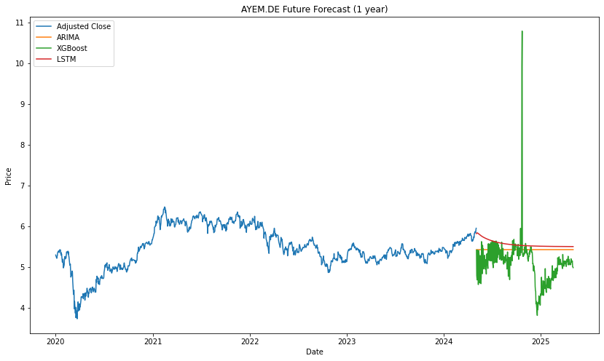
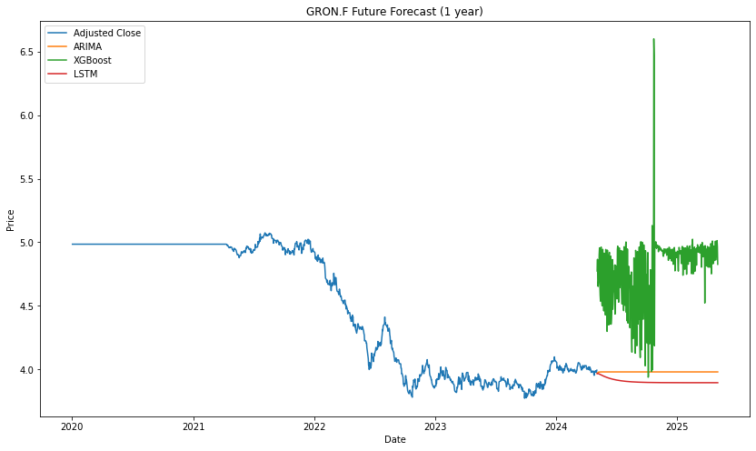
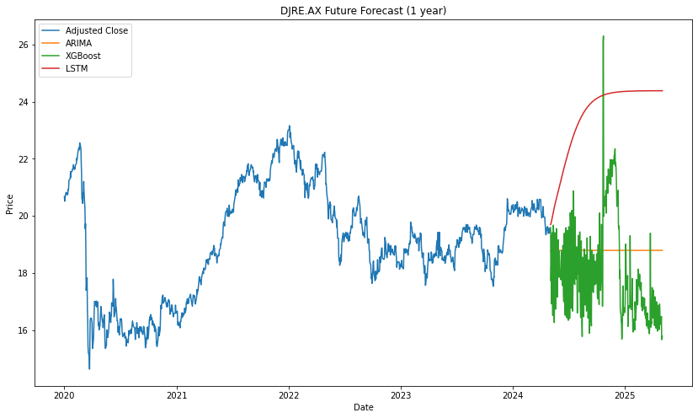
Future Forecasts With ARIMA, LSTM and XGBoost

Slide 12
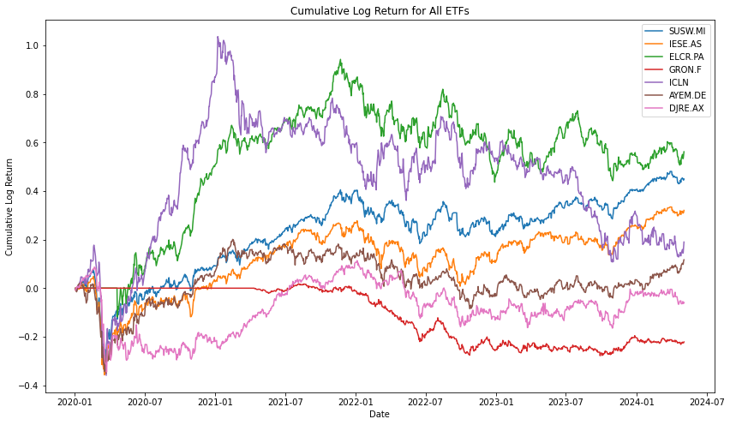
Cumulative Log Return for all ETF

Slide 13
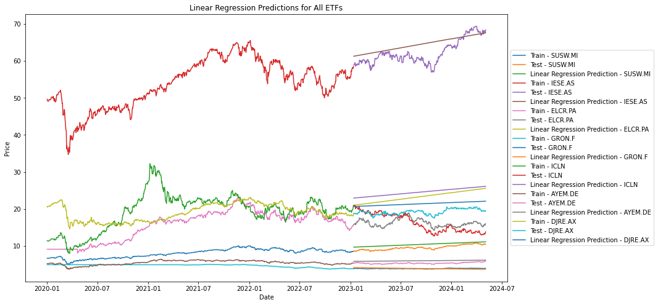
Plot for linear regression predictions

Slide 14
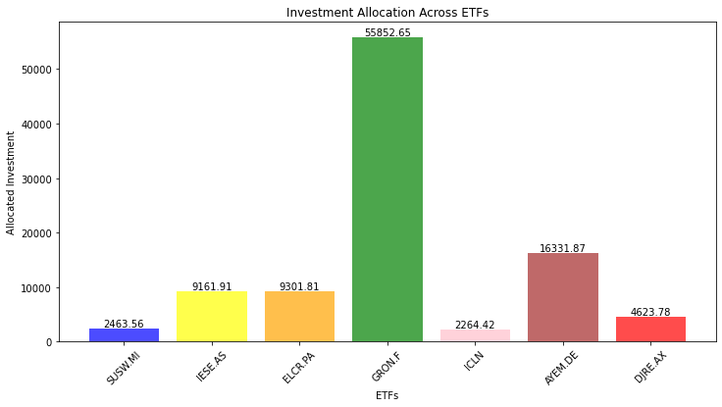
Portfolio Allocation
Investment with the example of 100000 Euro

Slide 15

Code overview
Programming : Python
IDE : Spyder
Major Library and PIP:
#!pip install numpy
#!pip install yfinance
#!pip install pandas
#!pip install pandas
#!pip install matplotlib
#!pip install statsmodels
#!pip install keras
#!pip install scikit-learn
#!pip install xgboost
#!pip install scipy
import numpy as np
import yfinance as yf
import pandas as pd
import matplotlib.pyplot as plt
from statsmodels.tsa.holtwinters import SimpleExpSmoothing, ExponentialSmoothing
from statsmodels.tsa.arima.model import ARIMA
from keras.models import Sequential
from keras.layers import LSTM, Dense, Dropout
from sklearn.preprocessing import MinMaxScaler
from sklearn.model_selection import train_test_split
from xgboost import XGBRegressor
from scipy.optimize import minimize

Slide 16


